Slide 1
Entity Component framework of Fools Engine
What do we actually need?
Work in progress
The engine needs to “run” the game – simulate and visualize it (render). This means that the game needs to be expressed in a way that is understandable by the engine. In other words, we need a model that the game will follow and the engine will use to interpret the game.
Not only we want to “run” a game, but also we need to make it. So we also need a framework that is going to ensure that developers working on a game can understand each other’s work and the results are compatible and coherent. This framework will also need to be runtime dynamic (both data and logic) so that iteration times would be small. We don’t want to recompile the whole game and the whole engine whenever a game designer wants to make a new type of game object or give it some new functionality.
The runtime model and development framework have slightly different requirements, so we could design and implement them separately to exploit unique opportunities and make tradeoffs that are not acceptable for the other. That however not only doubles the work but also requires a translation (necessarily automated for bigger projects) from one model to the other and creates an additional requirement of compatibility between them (it can be done however, e.g. Unity’s DOTS and GameObject).

Slide 2
Entity Component framework of Fools Engine
Design challenges
Work in progress
Volatile
Game development process
Complex
Usability
Users of all levels of familiarity and experience
Multiple users in one project
Both technical and non-technical users
Run-Time
Performant
Hardware scalable (up and down)
Stable and bug free
Game’s Data and Logic
Complex
Divers
Densely interdependent
Dynamic
Random
Integration
Engine functionalities
Systemic game features
Unique game features

Slide 3
Entity Component framework of Fools Engine
Entity-Component architecture
Work in progress
Entity-Component-System
!=
Entity-Component system
There is observable departure from inheritance-oriented scene representation and execution models in commercial game engines, online tutorials, blog posts, and conference presentations towards models with a composition-oriented approach where we have a featureless “entity” fulfilling service-locator pattern for reusable components. Those new models lay foundation for game development frameworks that are implemented in form of generic, runtime dynamic, game agnostic systems, so the term “Entity-Component system” has gained popularity.
There is also “Entity-Component-System” - data-oriented design pattern and aspiring paradigm sometimes used in implementing those models and a trendy buzzword.
This creates a great deal of confusion, as “Entity-Component system” and “Entity-Component-System” can only be differentiated from context. Not to mention improper use of those terms by people not knowing and understanding the difference. Additionally, game development frameworks in different game engines use incompatible fundamental nomenclatures (e.g. entity can be called Game Object, Pawn, Actor, Node…).

Slide 4
Entity Component framework of Fools Engine
Overview of existing design patterns
Work in progress
The concept of a scene representation architecture is not new. In fact, it's as old as the concept of a video game itself. Various excellent programmers in the past tackled with it and approached it from different perspectives and still do to this day. There are great lessons in their successes and failures.
Component design
 | Banned | Allowed | Enforced
Logic
Inheritance
Hierarchical components
Spatial components |  |  | ?
Dynamic allocations |  |  | ?
Pointer stability
Entity design
 | inheritance | composition
 |  | unique | universal
Object - OOP
ID only - DOD
Spatial hierarchy
What is a node | Component (entity should have a single root component)
 | Entity | Hardcoded
 |  | As component | Enforced
 |  |  | Optional
Definition | Parent
 | List of children
 | Siblings as linked list + first child
Reference type | Pointer | To entity
 |  | To component
 | ID
Application of changes | Once per frame (delta accumulation)
 | Instant
Global transform recalculation | Not cached (recalculation upon access)
 | Cashed | Recalculated upon change
 |  | Dirty flag set upon change | Recalculated once per frame
 |  |  | Recalculated upon access if needed
Skeleton's space | Local - translated to global for rendering
 | Global | Fixed
 |  | Recalculated when entity's transform changes
Components storage
Allocation strategy | Individually | malloc()
 |  | Custom
 | As container | Array
 |  | Vactor
 |  | Sparse set
Grouping | None (individual types)
 | Archetypes
 | Hybrid
Allocation coverage | Exact
 | Sparse | Empty tail optimized
 |  | Empty tail not optimized
Pagination | Yes | Virtual
 |  | Manual
 | No
Update
Sequential | Per entity
 | Per component | Individually
 |  | Through entity
Concurent | Actor model
 | Relational model | ECS
 |  | "Inverse" ECS
Execution order control
Multi-staged | Initialization
 | Simulation

Slide 5
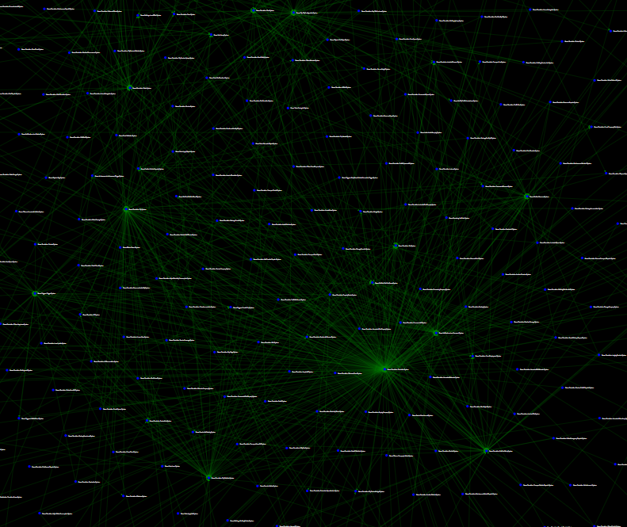
Entity Component framework of Fools Engine
State of the rot – usability
Work in progress
Over 1200 systems
in Cities: Skylines 2
not entities, but systems operating on them + dependencies
Game engines typically include 2 interfaces for their scene representation:
- for engine build-in systems (rendering, physics, etc.) and systemic game features (crowds, traffic, etc.)
- for unique, high-level gameplay features (player’s character movement, camera control, etc.).
The systemic side often creates implicit dependencies from the get-go and requires specific predefined setups to work, sometimes even as an undocumented technological debt. The gameplay side usually comes in form of scripting (C#, Lua, BluePrints, etc.) intended to be used by various types of designers and with full access to all data of the scene. Their lack of good programming principles and practices inevitably leads to abuse of that access.
Games are complex. That complexity is unavoidable and has to be resolved somewhere. Most entity-component frameworks settle down on a model that supports only a narrow set of design patterns for authoring a game’s logic. That puts all the responsibility and difficulty of managing that complexity on game developers. Their lack of intuitive grasp of the model and its design philosophy leads to misuse and overcomplication, even with a logical understanding of its architecture!

Slide 6
Entity Component framework of Fools Engine
State of the rot – utilization
Work in progress
Single, from a player’s perspective conceptually indivisible, element of the game (including its behavior) is implemented using multiple components and systems (and potentially entities) with various tricky dependencies between them, but also with their own internal complexities. Due to this coupling, but also interactions between game objects through both engine and scripting interfaces, games have extremely unintuitive and complicated execution flows. That makes reasoning about the game difficult (sometimes even literally impossible without actually running and testing it). Familiarizing yourself with existing game code or simply keeping up with it becomes a very big cognitive load. At the end of the development process, the game is too complex for anyone to know how it works anymore. Pieces of spaghetti code are also sometimes carried over to the next project as black boxes with legacy dragons and get stacked over time like a rotting onion.
But even with proper usage, a simple design of a scene’s execution model causes problems, because it cannot be suitable for all types of features. If it is closed and restrictive, developers will fight it with workarounds and dirty hacks. If it is open, it will cause inconsistencies and will result in a spaghetti of dependencies.

Slide 7
Entity Component framework of Fools Engine
Alternative - embracing complexity
Work in progress
Complex ≠ Difficult Simple ≠ Easy
Instead of denying the existence of games complexity, we could come to terms with it and accept its inevitability. Acceptance does not mean indifference towards the problem. Instead of pushing the responsibility down to game developers, we could provide them with tools for the proper expression of the game's logic.
Organization and structurization of both data and logic should be the fundamental roles of the scene representation framework. Putting data and logic in order properly and comprehensively using a framework is an occasion to conceptualize and optimize game code while keeping it manageable, extendable, and reusable. That requires a model that includes a comprehensive set of features for the representation of not only data but also execution flow. The complexity, diversity, generality and abstractness of its subject are an argument for the diversity of tools within the model! As long as we keep our framework's model composed in an intuitive way of standardized, corresponding concepts we can make as many tools for expressing the game as we need.
Complex does not mean difficult, and simple does not mean easy.

Slide 8
Entity Component framework of Fools Engine
Goals
Work in progress
Flexible
Favors extendable and modifiable game code
Allows for multiple ways of implementing features
Organizes game code
Intuitive
Provides multiple levels of conceptualization
Has corresponding rules on them
Has predictable execution flow
Favors simple standardized designs patterns
Fully symmetric API
Safe
Isolates game features
Has clear rules for data access and dependencies
Resolves spatial and execution order dependencies
Prevents initialization order issues
Performant
Build-in extensive parallelism (including engine-game parallelism)
Data oriented
Service oriented (pay for what you need)
Customizable
Unified (engine build-in features and game code)
Does not allow for data races

Slide 9
Entity Component framework of Fools Engine
Corner Stones
Work in progress
2 levels of logic: Behavior and System
Behavior deals with object’s internal state
System deals with world’s state
Component update
Mass update of components (ECS style)
Explicit execution flow control
No default update calls from the engine – enrollment always required
A simple way of controlling execution order with 2 levels of control
1 - Simulation stages (big sync-points)
2 - Numerical priorities for update enrolls
Comprehensive feature set
Provides methods to represent every aspect of a scene, including fully independent purely visual features (foliage, particles, etc.)
Different composition/abstraction layers to choose from to implement any game feature in a suitable way
Full isolation within the same conceptual layer
Trivial parallelization of updates and initialization
Component–component data transfer
Object–object data transfer
ECS Storage
Customizable optimizations
Cache-friendly iteration
In frame pointer stability – no reallocation during component/entity creation and deferred destruction
Build-in spatial hierarchy
Fully managed by the engine, hidden from the user
Automated propagation of transform changes
Global transform is always accurate on access
Children are defined as a linked list to avoid additional heap allocations and indirections during hierarchy traversal
Entity-Component-System compliant components storage architecture
Storage structure reflects hierarchy structure (cash-friendly traversal)
Dictates update order (parent => child)

Slide 10
Entity Component framework of Fools Engine
Decisions => hybrid everywhere
Work in progress
Entity
ID only
Some components universally guaranteed and protected (e.g. transform)
Other dynamically added
Component storage
Off-the-shelf solution – EnTT library
Sparse sets with manual pagination
Archetype-like customizable optimizations
Execution order control
Multi-staged execution
Explicit per instance update enrolls
Explicit numerical priorities per update enroll for finer control
Spatial hierarchy
Update calls
Entity is a node stored as a component
Concurrent – hybrid
Definition: siblings as linked list + first child + parent
Reference as entity ID
Application of transform changes: instant
Global transform: cashed, recalculated upon access if needed (dirty flag)
Skeleton space: local
No caching of global transforms of spatial components
Actor model:
Actor is a subsection of the entities’ hierarchy representing a single object (car, NPC, etc.)
Actors are updated in the order defined by the hierarchy
Internal execution of an actor is sequential using Behaviors that operate on components
Component
Logic allowed and not enforced, banned referencing other components/entities – a black box with no dependencies
Inheritance enforced (basic types)
Hierarchical components not available
Spatial components allowed
External storage allowed, but discouraged
Pointer stability in frame, but not across frames – deferred destructions
Relational model (ECS)
Further inheritance allowed (enforced), but considered as independent types

Slide 11
Entity Component framework of Fools Engine
Structure overview
Work in progress
World
Actor
Mostly data, but can have logic
Dependence free
Subsection of hierarchy of entities
Dependance free
Component
Entity
Abstract container for components
Organized in a hierarchy
Examples: players character, car, NPC
Examples: head, main body, weapon
Examples: animation graph, skeletal mesh
World
Separation of indifferent domains
Scene
Specialization of storage structure
Different levels/maps in game
Examples: gameplay, particles, foliage
Root Entity
Head Entity
Entity
Entity
Entity
Head Entity
Entity
Head Entity
Entity
Entity
Entity
Entity
Entity
Actor
Actor
Actor

Slide 12
Entity Component framework of Fools Engine
Execution and data routing
Work in progress
System
System
Behavior
Execution flow control between Components
Component–component data transfer
Actor’s “internal system” – owned by Actor
Examples: animation, characterController
Uses direct component references (entity IDs)
System
Global – owned by World
2 roles:
Components update (ECS style)
It can be an opt-in or opt-out service
Examples: AI stim system, crowd sim system
Actor-actor data transfer by state injection (similarly to messages in the actor model)
Actors update is an update of its behaviors
2 roles:
Can use direct component references (entity IDs)
Opt-in/out can be direct or using an empty flag component and permanent or one-time
Systems register for update from the world
Behaviors register for update from Actor
Actor
Actor
Component
Component
Component
Component
Component
Component
Component
Component
Actor
Behavior
Execution
Component
Component
Data transfer
Component
Component

Slide 13
Entity Component framework of Fools Engine
Update Order
Work in progress
Frame Start | Pre-Physics | Physics | Post-Physics | Frame End | Post Frame
Actors
Systems
Actors
Systems
Actors
Systems
Actors
Systems
Actors
Systems
Engine
System
Parallel workload
Parallel workload
Parallel workload
System
Parallel workload
Parallel workload
System
Parallel workload
Parallel workload
System
System
Worker 1
Worker 2
Worker 3
Worker 4
Actor
Actor
Actor
Actor
Actor
Actor
Actor
Actor
Actor
Actor
Actor
Actor
Actor
Actor
Actor
Actor
Actor
Actor
Actor
Actor
Actor
Actor
Actor
Actor
Actor
Actor
Actor
Actor
Actor
Actor
Actor
Actor

Slide 14
Entity Component framework of Fools Engine
Component
Work in progress
Component Empty Struct
Flag Component Empty Struct
Data Component Standard
Spatial Component Adds transform offset
Protected Component Not retrievable (engine managed)
Basic building block
Can have data
Can have logic
Mostly utility methods for operating on that component
Can have resource references
Can restrict access to its internal state and expose getters and setters
Can perform its own update, but engine does not provide update call
Stored in global ECS storage
If inherits from another component they are considered as unrelated types
Only one instance of a given component type per one EntityID in a world
Can have logic
Can be updated by a Behavior or a System (directly or by a call)
Cannot reference anything in the scene (“black box”)

Slide 15
Entity Component framework of Fools Engine
Entity
Work in progress
Scene Hierarchy
Defined by dedicated component – HierarchyNode
Used to organize storage of some components (e.g. Tags, HierarchyNode, Transforms) for cash friendly traversals
All Entities in a Gameplay World are part of one spatial hierarchy
Fully managed by engine
Children defined as linked list
Children are sorted by their EntityID
Cashes information about its hierarchy depth and children count
Entity class
A thin wrapper around World* and EntityID acting as a handle
Provides utility API for operating on components of an Entity
Provides additional handles and API to protected components responsible for carrying out functionalities of the whole model (e.g. Transform, HierarchyNode)
Abstract container for Components
Abstract container for conceptually/spatially connected components
Is represented in memory as uint32_t - EntityID
EntityID acts as a storage access key to components of an Entity
Can contain only 1 instance of each component type
Every Entity has LocalTransform, GlobalTransform, EntityName, HierarchyNode and Tags components
Unique EntityIDs
NullEntityID != 0, but constexpr
RootEntityID = 0

Slide 16
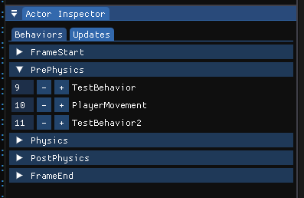
Entity Component framework of Fools Engine
Actor
Work in progress
Numerical priorities of Behavior updates can be modified in editor’s GUI on a per-instance basis
Owns and manages Behaviors
Provides Update calls to Behaviors
Abstract object
Abstract object representing single “thing” from players perspective (e.g. player’s character, NPC, vehicle)
Resolves execution order dependencies between Behaviors within each simulation stage using numerical priorities
Caches a dedicated list of Behaviors and their overridden Update methods enrolled for update per each simulation stage
Uses a subsection of hierarchy of Entities for storing it’s Components
Stores it’s own data in an ActorData Component in a HeadEntity
Actor class
Thin wrapper around Entity class
Provides utility API for operating on Behaviors, Entities and Components constituting an Actor
Update of all Actors is a multithreaded graph search of scene hierarchy
The engine updates actors in order defined by a spatial hierarchy (parent => child) to ensure the correctness of Transform changes propagation
Actor update is an update of all it’s Behaviors
Behavior
Updates Component instances in a single Actor
Facilitate control of data and execution flow between Components
Can have properties and transient run-time state
Update
An Actor’s hierarchy is maintained in parallel to Entities hierarchy as a simplified, collapsed version

Slide 17
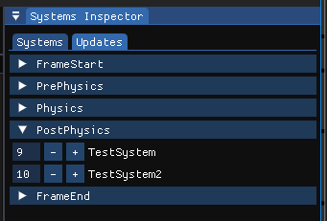
Entity Component framework of Fools Engine
System
Work in progress
Roles
Execution
Actor-Actor communication using state injection (similarly to messages in actor model)
Global – owned by World
World resolves execution order dependencies between Systems within each simulation stage using numerical priorities
Systems register for update during a particular frame simulation stage (can register for multiple stages)
System cannot reference other systems
Systems can parallelize internally their workload
Systems are executed sequentially by a World
2 roles:
Operates as a service for actors (behaviors and components):
Updating multiple instances of the same Component type (ECS style)
Can be an opt-in or opt-out service
Enrollment can be direct call or using FlagComponent
Enrollment can be permanent or one-time
Systems have internal locks to resolve concurrent accesses from Actors
World caches a dedicated list of Systems and their overridden Update methods enrolled for update per each simulation stage
Systems numerical update priorities can be modified in the editor’s GUI

Slide 18
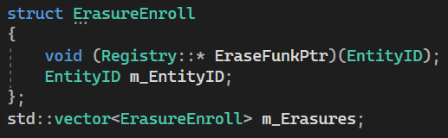
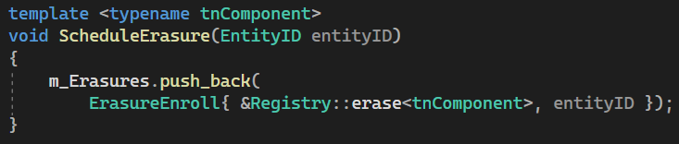
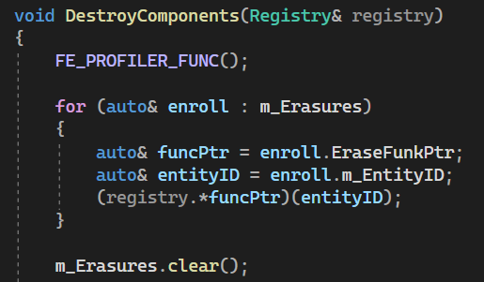
Entity Component framework of Fools Engine
Deletions
Work in progress
Component Destruction
Pointer stability issue
Deletion of a Component (and by so also deletion of Entities and Actors) causes reshuffling of other Components of the same type in memory - invalidation of pointers and references
All deletions has to be deferred to the end of the frame to achieve in-frame pointer stability
Deferring
Actors – deletion handled as deletion of underlying Entities
Behaviors and Systems are not affected by this issue, as they do not reside in ECS storage
Entities – marking with DestroyFlag component
Components – enrolling for destruction in a buffer of EntityIDs and pointers to the destruction method applicable for a given type of component
Component deletion is handled first, then Entities, as they may relate to the same components

Slide 19
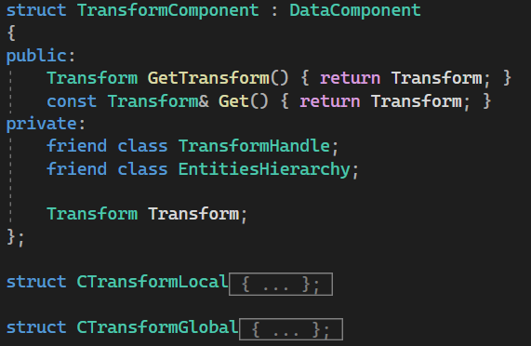
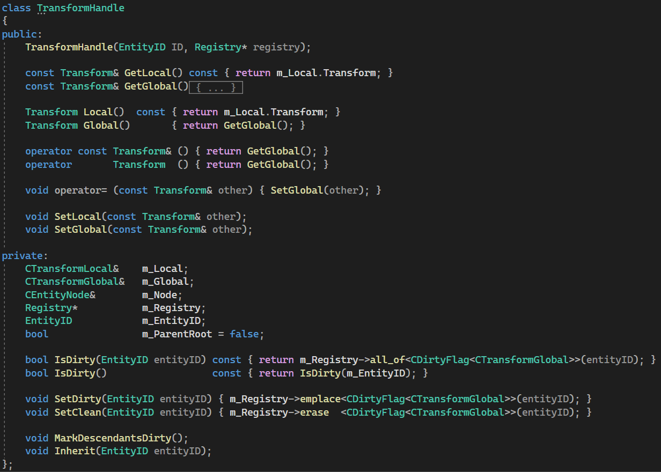
Entity Component framework of Fools Engine
Transform
Work in progress
State Propagation
DirtyFlag component
Marks Global transform as „outdated”
Two components: Global and Local
Global is recalculated upon access if necessary (if marked as „dirty”) using a hierarchy chain starting from the closest „clean” ancestor
Emplaced in all descendant Entities upon Global modification (Local modification implies Global modification)
Local is always accurate, Global appears as always accurate
Availability
Not accessible directly
this->Global = parent->Global + this->Local
Special handle provides a safe interface to operate on either Local or Global transform
Overloaded operators allowing to treat it as if it was Global transform itself
Local recalculated upon change, Global recalculated upon access if needed (has changed)

Slide 20
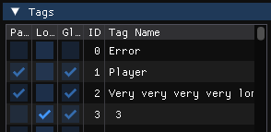
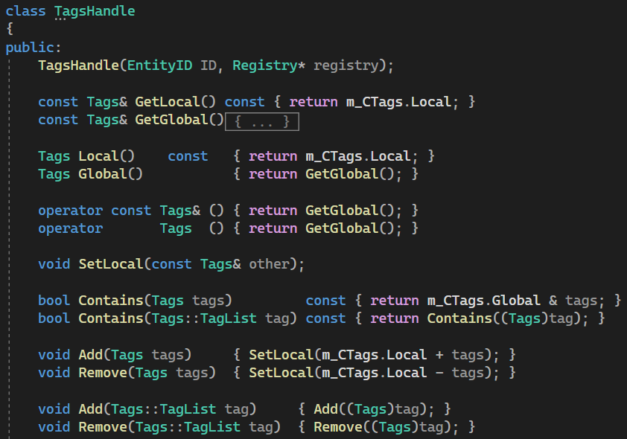
Entity Component framework of Fools Engine
Tags
Work in progress
Tags can be inspected end easily edited in level editor
Propagation
Two parts: Global, Local (in one component)
this->Global = parent->Global + this->Local
Just bitset with bit flags - each bit flag represents an existence of a tag
Tags
Meant to be used to easily recognize given Entity’s purpose and conceptual identity
Using it to send info down the hierarchy should be avoided
Entity class provides utility methods, like FindTagOrigin()
Propagates down the hierarchy the same way as Transform and has similar handle, but triggers full recalculation upon each change
Can only be modified in systems, not in actors

Slide 21
Entity Component framework of Fools Engine
Hierarchy Storage
Work in progress
Order of Components in storage reflects logical structure of the hierarchy
Siblings are grouped next to each other
Siblings are sorted based on their EntityID (logically in a linked list of Node Components and in storage)
Groups of siblings are grouped based on their hierarchy level
Groups of siblings on the same hierarchy level are sorted based on their parent EntityID
Storages of hierarchy related components are synchronized: EntityNode, LocalTransform, GlobalTransform, Tags
Root
Lvl 1
Lvl 2
0 | 3 | 7 | 16 | 31 | 6 | 19 | 18 | 45 | 46 | 33 | 37
Maintenance
This order is not fully guaranteed, as maintaining it at all times would be too expensive
Instead, it is recreated once per frame after the simulation and before rendering
Its purpose is to make hierarchy traversal more cash friendly
Sorting algorithm
Sorting is first performed on an array of just EntityIDs and then resulting permutation applied to component storages in linear time (sorting does not swap components unnecessarily)
Sorting is performed in 2 stages:
1: QuickSort groups each hierarchy level recursively
2: Each level is then sorted in parallel with std::sort
Async, amortized approach is still considered

Slide 22
Entity Component framework of Fools Engine
Storage Customization
Work in progress
Grouping components
Limitations
Storages of component types managed by a Group lose pointer stability upon component creation
They cannot be created by Actors (concurrently running Actor’s pointers and references to it’s own components will get invalidated) – creation should happen within a global system
They cannot be accessed using CompPtr (automated cashing of component pointer within one frame) – go through registry/group using raw EntityID each time
Entities’ Hierarchy related Components (e.g. Transforms, Tags, EntityNode) are already grouped
Protected Components cannot be included in a Group (e.g. ActorData, Tags)
Actor related Components (ActorData, ActorNode) are already grouped
Work in progress
Custom Storage
Limitations
Custom storage cannot be involved in a Group
Work in progress
Work in progress
ECS implementation
The current implementation of ECS storage is an external open-source library - EnTT
It provides additional customization features: Groups (synchronizing orders of components) and custom component storages (accessed through storage ID, not type)
Direct usage of those customizations can result in the breaking of fundamental design cornerstones of the framework
Proper integration of those is not yet designed

